Slide 1
Part 2 Process management
Chapter 3 Processes

Slide 2
Content
Process Concept
Process Scheduling
Operations on Processes
Interprocess Communication
Examples of IPC Systems
Communication in Client-Server Systems

Slide 3
Objectives
To introduce the notion of a process -- a program in execution, which forms the basis of all computation
To describe the various features of processes, including scheduling, creation and termination, and communication
To describe communication in client-server systems

Slide 4
1. Process Concept
Process Definition
Process State
Process Control Block (PCB)

Slide 5

Early computer systems
Allowed only one program to be executed at a time
Had complete control of the system and had access to all the system's resources
Multiple programs are carried out in fixed order
（顺序性）

Slide 6
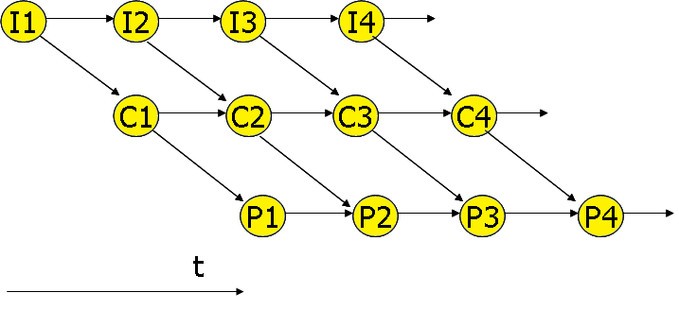
Concurrent execution---now
multiple programs
these needs resulted in the notion of a process

Slide 7
Some Problems for Process Management
How to dispatch（分派） CPU to multi-processes
How to allocate resource to multi-processes and avoid deadlock and hungry
How to implement the process communication

Slide 8
(1) Process Definition
Process – a program in execution; process execution must progress in sequential fashion
A process includes:
  program counter
  stack
  data section

Slide 9
(1) Process Definition （Cont’)
An operating system executes a variety of programs:
  Batch system – jobs
  Time-shared systems – user programs or tasks
Textbook uses the terms job and process almost interchangeably

Slide 10
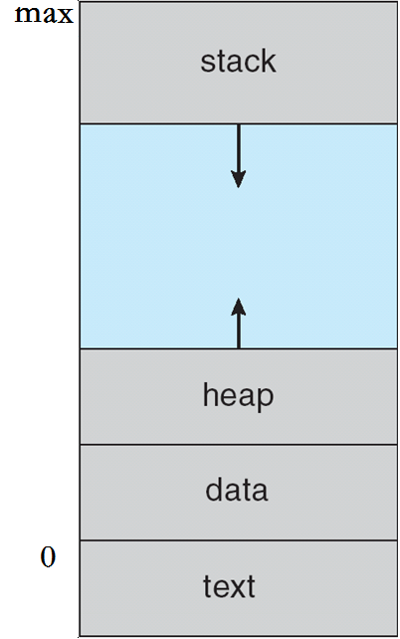
Process in Memory
Stack containing temporary data( Function parameters, return addresses, local variables)
2. Current activity including program counter, processor registers
3. Heap containing memory dynamically allocated during run time
4.Data section containing global variables
5. The program code, called text section

Slide 11
Process Concept
进程的基础知识
  进程更能真实地描述任务的并发执行.
  进程由程序和数据两部分组成.
  进程是动态的:进程有生命周期，有诞生、有消亡，是短暂的过程.
  一个程序对应多个进程.
  进程具有创建其它进程的功能

Slide 12
Process Concept (Cont’)
进程特征
  结构特征 : 进程实体由程序段、数据段和PCB构成；
  动态性: 进程是程序的一次执行过程；
  并发性: 多个进程同存于内存中，且在一段时间内同时运行，是进程的重要特征；
  独立性: 进程是独立运行、独立分配资源的基本单位；
  异步性: 进程按照独立的、不可预知的速度向前推进。
  交互性: 进程之间需要交互

Slide 13
(2)Process State
As a process executes, it changes state
  new （新建） --- The process is being created
  Running（执行） --- Instructions are being executed
  waiting （等待）--- The process is waiting for some event to occur（或者阻塞状态 Blocked）
  ready （就绪 ）--- The process is waiting to be assigned to a processor
  terminated （终止 ）--- The process has finished execution

Slide 14

Diagram of Process State

Slide 15
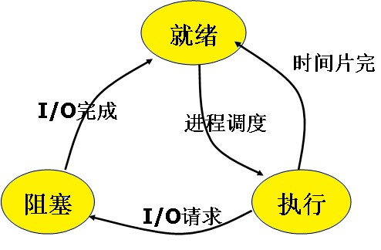
进程的三种基本状态及其转换

Slide 16
(3)Process Control Block (PCB)
Information associated with each process
Process state
Program counter
CPU registers
CPU scheduling information
Memory-management information
Accounting information
I/O status information

Slide 17
PCB表
系统把所有PCB组织在一起，并放在内存固定区域，就构成了PCB表。
  链表
  索引表
  PCB表的大小决定了系统中最多可同时存在的进程个数，称为系统的并发度
Notes:
链表：同一状态的进程其PCB成一链表，多个状态对应多个不同的链表
各状态的进程形成不同的链表：就绪链表、阻塞链表
索引表：同一状态的进程归入一个index表（由index指向PCB），多个状态对应多个不同的index表
各状态的进行形成不同的索引表：就绪索引表、阻塞索引表

Slide 18

PCB组织方式 --- 链接方式
PCB链接队列示意图

Slide 19

PCB组织方式 ---索引方式
按索引方式组织PCB

Slide 20
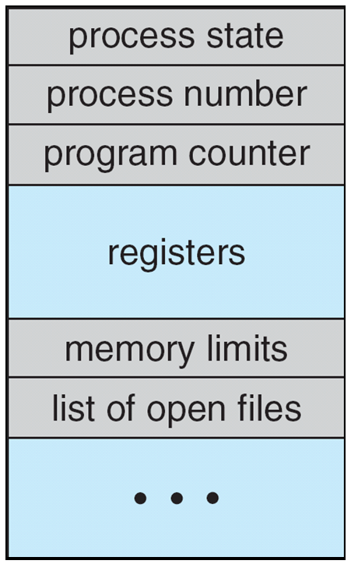
Process Control Block (PCB)

Slide 21
进程控制块(PCB)信息
进程标识符
处理机状态
进程调度信息
进程控制信息

Slide 22
进程控制块(PCB)信息---进程标识符
进程标识符：用于唯一地标识进程。一个进程通常有两种标识符：
  内部标识符。操作系统为每一个进 程赋予一个数字标识符，通常是一个进程的序号。内部标识符方便系统使用。
  外部标识符。它由创建者提供，通常是由字母、数字组成，由用户(进程)进程在访问该时使用。为了描述进程的家族关系， 还应设置父进程标识及子进程标识。此外，还可设置用户标识，以指示拥有该进程的用户。

Slide 23
进程控制块(PCB)信息----处理机状态
处理机状态:由处理机的各种寄存器中的内容组成
  通用寄存器
  指令计数器:存放了要访问的下一条指令的地址；
  程序状态字PSW，其中含有状态信息，如条件码、执行方式、 中断屏蔽标志等；
  用户栈指针， 存放过程和系统调用参数及调用地址。栈指针指向该栈的栈顶。

Slide 24
进程控制块（PCB）信息---进程调度信息
进程调度信息：
  进程状态： new （新建）， Running（执行）等
  进程优先级：用于描述进程使用处理机的优先级别的一个整数， 优先级高的进程应优先获得处理机
  其它信息：与进程调度算法有关
  事件：是指进程由执行状态转变为阻塞状态所等待发生的事件，即阻塞原因

Slide 25
进程控制块（PCB）信息（cont’)
进程控制信息
  程序和数据的地址
  进程同步和通信信息，进程同步和进程通信必需的信息：消息队列指针、信号量等，它们可能全部或部分地放在PCB中；
  链接指针：当前进程(PCB)所在队列中的下一个进程的PCB的首地址。

Slide 26

CPU Switch From Process to Process

Slide 27
Threads
process has a single thread of execution
Consider having multiple program counters per process
  Multiple threads of control -> threads
Must then have storage for thread details, multiple program counters in PCB
See next chapter

Slide 28
2.Process Scheduling
Objective：
Maximize CPU use （CPU资源利用率）
Quickly switch processes onto CPU for time sharing（进程切换）
Notes:
Maximize CPU use, quickly switch processes onto CPU for time sharing
Process scheduler selects among available processes for next execution on CPU
Maintains scheduling queues of processes
Job queue – set of all processes in the system
Ready queue – set of all processes residing in main memory, ready and waiting to execute
Device queues – set of processes waiting for an I/O device
Processes migrate among the various queues

Slide 29
2.Process Scheduling (Cont’)
Task：
Process scheduler （进程调度）
  selects processes for next execution on CPU
Maintains scheduling queues of processes（维护调度队列）
  Job queue – set of all processes in the system
  Ready queue – set of all processes residing in main memory, ready and waiting to execute
  Device queues – set of processes waiting for an I/O device
  Processes migrate （迁移）among the various queues
Notes:
Maximize CPU use, quickly switch processes onto CPU for time sharing
Process scheduler selects among available processes for next execution on CPU
Maintains scheduling queues of processes
Job queue – set of all processes in the system
Ready queue – set of all processes residing in main memory, ready and waiting to execute
Device queues – set of processes waiting for an I/O device
Processes migrate among the various queues

Slide 30
（1）Scheduling Queues
Job queue
Ready queue: linked list
Device queue
For example : Device queue……

Slide 31


Slide 32
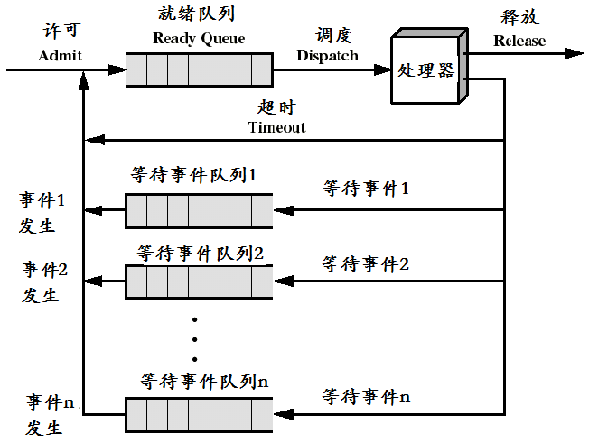
进程队列
就绪队列无优先级
当事件n发生，对应队列移近就绪队列

Slide 33
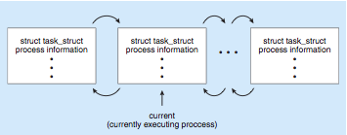
Process Representation in Linux
Represented by the C structure task_struct
task_struct成员：
pid t pid; /* process identifier */
long state; /* state of the process */
unsigned int timeslice /* scheduling information */
struct taskstruct *parent; /* this process’s parent */
struct listhead children; /* this process’s children */
struct filesstruct *files; /* list of open files */
struct mmstruct *mm; /* address space of this pro */

Slide 34

(2)Schedulers
Representation of Process Scheduling
Queueing diagram represents queues, resources, flows
Queueing diagram

Slide 35
Schedulers (Cont’)
Long-term scheduler （长期调度或高级调度）
  (or job scheduler) – selects which processes should be brought into the ready queue
  作业调度或宏观调度
Short-term scheduler （短期调度或低级调度）
  (or CPU scheduler) – selects which process should be executed next and allocates CPU
  Sometimes the only scheduler in a system

Slide 36
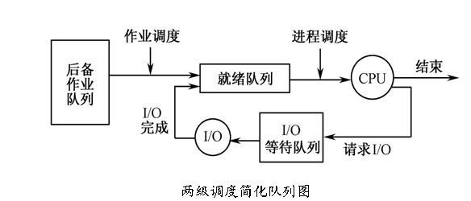
(2)Schedulers (Cont’)

Slide 37
Schedulers (Cont’)
Short-term scheduler： fast ---- milliseconds
Long-term scheduler：slow---- seconds, minutes
Processes can be described as either:
  I/O-bound process – spends more time doing I/O than computations, many short CPU bursts
  CPU-bound process – spends more time doing computations; few very long CPU bursts

Slide 38
Short-term scheduling
从内存中的就绪进程队列中选择一个进程来执行。即，CPU调度。
分为抢占的和非抢占的

Slide 39
Short-term scheduling
抢占方式(Preemptive Mode)
允许暂停某个进程的执行重新分配处理机
抢占的原则有：
  优先权原则。
  时间片原则。

Slide 40
Medium-term scheduling
中级调度又称中程调度(Medium-Term Scheduling)。
为了提高内存利用率和系统吞吐量。
使那些暂时不能运行的进程不再占用宝贵的内存资源，而将它们调至外存上去等待，把此时的进程状态称为就绪驻外存状态或挂起状态。
重新调入内存：当这些进程重新具备运行条件、且内存有空闲时，由中级调度来重新调入内存，并修改其状态为就绪状态，挂在就绪队列上等待进程调度。

Slide 41

Addition of Medium Term Scheduling
Medium-term scheduler remove processed from memory to reduce the degree of multigramming.
Later, the process can be reintroduced into memory
execution can be continue
called swapping（交换技术）.
Notes:
中程调度将进程从内存中移除（不再占用CPU）并降低了多道程序度。稍后再把进程重新载入内存并从停止的地方继续运行。这种机制被称为交换。通过中程调度程序，进程被换出，然后被换入。中程调度可以改善进程混合集，或者内存需求过多或者太多空闲了，就有必要进行交换。

Slide 42
Process Scheduling
Maximize CPU use, quickly switch processes onto CPU for time sharing
Process scheduler selects among available processes for next execution on CPU
Maintains scheduling queues of processes
  Job queue – set of all processes in the system
  Ready queue – set of all processes residing in main memory, ready and waiting to execute
  Device queues – set of processes waiting for an I/O device
  Processes migrate among the various queues

Slide 43
Multitasking in Mobile Systems
Some mobile systems (e.g., early version of iOS) allow only one process to run, others suspended
Due to screen real estate, user interface limits iOS provides for a
  Single foreground process- controlled via user interface
  Multiple background processes– in memory, running, but not on the display, and with limits
Notes:
Limits include single, short task, receiving notification of events, specific long-running tasks like audio playback

Slide 44
Multitasking in Mobile Systems(cont)
Android runs foreground and background, with fewer limits
  Background process uses a service to perform tasks
  Service can keep running even if background process is suspended
  Service has no user interface, small memory use

Slide 45
(3) Context Switch
CPU switches to another process
Save the state of the old process and load the saved state for the new process via a context switch.
Context of a process represented in the PCB
Notes:
When CPU switches to another process, the system must save the state of the old process and load the saved state for the new process via a context switch.
Context of a process represented in the PCB
Context-switch time is overhead; the system does no useful work while switching
The more complex the OS and the PCB -> longer the context switch
Time dependent on hardware support
Some hardware provides multiple sets of registers per CPU -> multiple contexts loaded at once

Slide 46
CPU Switch From Process to Process

Slide 47
(3) Context Switch (Cont’)
Context-switch time is overhead; the system does no useful work while switching
Time dependent on hardware support
  Some hardware provides multiple sets of registers per CPU -> multiple contexts loaded at once
Notes:
When CPU switches to another process, the system must save the state of the old process and load the saved state for the new process via a context switch.
Context of a process represented in the PCB
Context-switch time is overhead; the system does no useful work while switching
The more complex the OS and the PCB -> longer the context switch
Time dependent on hardware support
Some hardware provides multiple sets of registers per CPU -> multiple contexts loaded at once

Slide 48
Process Context (Cont’)
Process Context(进程上下文)是进程执行活动全过程的静态描述。包括：
  计算机系统中执行该进程有关地各种寄存器的值
      例如通用寄存器、程序计数器PC、程序状态字寄存器PS，等
  程序段在经过编译之后形成的机器指令代码集（或称正文段）、数据集
  各种堆栈值
  PCB结构。

Slide 49
3.Operations on Processes
Process Creation
Process Termination

Slide 50
（1）Process Creation
Parent process create children processes, which, in turn create other processes, forming a tree of processes
Generally, process identified and managed via a process identifier (pid)

Slide 51
（1）Process Creation
Resource sharing
  Parent and children share all resources
  Children share subset of parent’s resources
  Parent and child share no resources
Execution
  Parent and children execute concurrently
  Parent waits until children terminate

Slide 52
Process Creation (Cont’)
Address space
  Child duplicate of parent
  Child has a program loaded into it
UNIX examples
  fork system call creates new process
  exec system call used after a fork to replace the process’ memory space with a new program

Slide 53
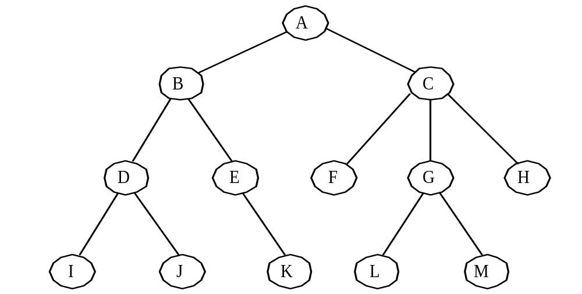
Process Creation (Cont’)
进程图(Process Graph)
    Spawned（产生） by existing process → process tree
进程树

Slide 54
引起创建进程的事件
用户登录
Interactive（交互） logon
(2)作业调度
New batch job
(3) 提供服务
Created by OS to provide a service example: printing
(4) 应用请求: 用户程序自己创建进程, 例如 CreateProcess

Slide 55
进程的创建过程
(1)申请空白PCB。
(2) 为新进程分配资源。
(3) 初始化进程控制块。
(4) 将新进程插入就绪队列，如果进程就绪队列能够接纳新进程， 便将新进程插入就绪队列。

Slide 56

Process Creation

Slide 57
C Program Forking Separate Process
#include <sys/types.h>
#include <studio.h>
#include <unistd.h>
int main()
{
pid_t pid;
/* fork another process */
pid = fork();
if (pid < 0) {
/* error occurred */
fprintf(stderr, "Fork Failed");
return 1;
}
else if (pid == 0)
{ /* child process */
execlp("/bin/ls", "ls", NULL);
//从PATH 环境变量中查找文件并执行
}
else { /* parent process */
/* parent will wait for the child */
wait (NULL);
printf ("Child Complete");
}
return 0; }

Slide 58
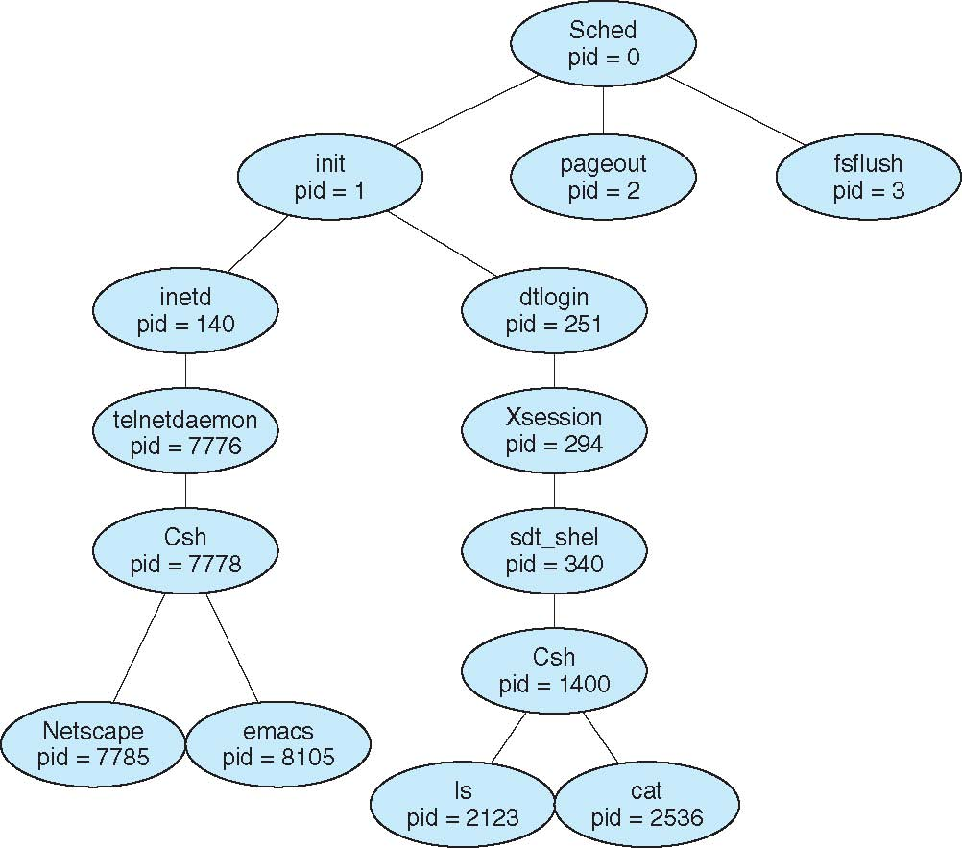
A Tree of Processes on Solaris

Slide 59
（2）Process Termination
Process executes last statement and asks the operating system to delete it (exit)
  Output data from child to parent (via wait)
  Process’ resources are deallocated by operating system
Notes:
Process executes last statement and asks the operating system to delete it (exit)
Output data from child to parent (via wait)
Process’ resources are deallocated by operating system
Parent may terminate execution of children processes (abort)
Child has exceeded allocated resources
Task assigned to child is no longer required
If parent is exiting
Some operating systems do not allow child to continue if its parent terminates
All children terminated - cascading termination

Slide 60
Process Termination(cont’)
Parent may terminate execution of children processes (abort)
  Child has exceeded allocated resources
  Task assigned to child is no longer required
  If parent is exiting
    Some operating systems do not allow child to continue if its parent terminates
      All children terminated - cascading termination
Notes:
Process executes last statement and asks the operating system to delete it (exit)
Output data from child to parent (via wait)
Process’ resources are deallocated by operating system
Parent may terminate execution of children processes (abort)
Child has exceeded allocated resources
Task assigned to child is no longer required
If parent is exiting
Some operating systems do not allow child to continue if its parent terminates
All children terminated - cascading termination

Slide 61
Reasons for Process Termination
Reasons for Process Termination
  Halt command
  User log off
  User program exit
  Program error（e.g. no resource for use）
  Normal completion
  Time limit exceeded
  Memory unavailable

Slide 62
引起进程终止(Termination of Process)的事件
任务正常结束
  进程已经运行完成
    例如，在批处理系统中，通常在程序的最后安排一条Halt指令或终止的系统调用。当程序运行到Halt指令时，将产生一个中断，去通知OS本进程已经完成。
    在分时系统中，用户可利用Logs off去表示进程运行完毕， 此时同样可产生一个中断，去通知OS进程已运行完毕。

Slide 63
引起进程终止(Termination of Process)的事件
任务异常结束。出现某些错误和故障而迫使进程终止
  越界错误。这是指程序所访问的存储区，已越出该进程的区域；
  保护错。进程试图去访问一个不允许访问的资源或文件
  非法指令。程序试图去执行一条不存在的指令。
  特权指令错。用户进程试图去执行一条只允许OS执行的指令；
  运行超时。进程的执行时间超过了指定的最大值；
  等待超时。进程等待某事件的时间， 超过了规定的最大值；
  算术运算错。进程试图去执行一个被禁止的运算，例如，被0除
  I/O故障。这是指在I/O过程中发生了错误等。

Slide 64
引起进程终止(Termination of Process)的事件
外界干预。进程应外界的请求而终止运行
  操作员或操作系统干预。
  父进程请求。 由于父进程具有终止自己的任何子孙进程的权利， 因而当父进程提出请求时，系统将终止该进程；
  父进程终止。 当父进程终止时，OS也将他的所有子孙进程终止。

Slide 65
进程的终止过程
根据被终止进程的标识符，从PCB集合中检索出该进程的PCB，从中读出该进程的状态。
若被终止进程正处于执行状态，应立即终止该进程的执行，并置调度标志为真，用于指示该进程被终止后应重新进行调度。
若该进程还有子孙进程，还应将其所有子孙进程予以终止，以防他们成为不可控的进程。
将被终止进程所拥有的全部资源，或者归还给其父进程， 或者归还给系统。
将被终止进程(它的PCB)从所在队列(或链表)中移出， 等待其他程序来搜集信息。

Slide 66
进程的阻塞与唤醒(Blocking and wake up)
引起进程阻塞和唤醒的事件
  请求系统服务
  启动某种操作
  新数据尚未到达
  现有进程任务完成，无新工作可做

Slide 67
进程的阻塞与唤醒(Blocking and wake up)
进程阻塞过程:
  调用阻塞原语block把自己阻塞。
  进入block过程后，应先立即停止执行，把进程控制块中的现行状态由“执行”改为阻塞；
  将PCB插入阻塞队列。应将本进程插入到具有相同事件的阻塞(等待)队列。
  将处理机分配给另一就绪进程，并进行切换，亦即，保留被阻塞进程的处理机状态(在PCB中)，再按新进程的PCB中的处理机状态设置CPU的环境。

Slide 68
进程的阻塞与唤醒(Blocking and wake up)
进程唤醒过程
  当被阻塞进程所期待的事件出现时，如I/O完成或其所期待的数据已经到达
  有关进程(比如，用完并释放了该I/O设备的进程)调用唤醒原语wakeup( )，将等待该事件的进程唤醒
  唤醒原语执行的过程是：首先把被阻塞的进程从等待该事件的阻塞队列中移出，将其PCB中的现行状态由阻塞改为就绪，然后再将该PCB插入到就绪队列中。

Slide 69
进程的挂起与激活
(Pending the activation process)
进程的挂起
  当出现了引起进程挂起的事件时，比如，用户进程请求将自己挂起
  或者父进程请求将自己的某个子进程挂起， 系统将利用挂起原语suspend( )将指定进程或处于阻塞状态的进程挂起。

Slide 70
进程的挂起与激活
(Pending the activation process)
进程的激活过程
  当发生激活进程的事件时
  例如，父进程或用户进程请求激活指定进程，若该进程驻留在外存而内存中已有足够的空间时，则可将在外存上处于静止就绪状态的进程换入内存。系统将利用激活原语active( )将指定进程激活。

Slide 71
4.Interprocess Communication
Processes within a system may be independent or cooperating
Cooperating process can affect or be affected by other processes, including sharing data
Reasons for cooperating processes:
  Information sharing
  Computation speedup
  Modularity
  Convenience

Slide 72
Interprocess Communication(cont’)
Cooperating processes need interprocess communication (IPC)
models of IPC
  Shared memory共享存储器系统
  Message passing消息传递系统
  Pipe管道

Slide 73
（1）Models of IPC--- Shared memory
基于共享数据结构的通信方式。
基于共享存储区的通信方式。

Slide 74
Shared memory mapping
shared
shared
stack
stack
...
...
heap
heap
data
data
text
text

Slide 75

Communications Models

Slide 76
（2）Models of IPC--- Message passing
消息传递机制都是用得最广泛的一种进程间通信的机制。
在消息传递系统中，进程间的数据交换，是以格式化的消息(message)为单位的；
通信命令(原语)可以大大减化通信程序编制的复杂性，获得广泛的应用。
消息传递系统的通信方式属于高级通信方式。
又分为直接通信方式和间接通信方式两种。

Slide 77
（3）Models of IPC--- Pipe
所谓“管道”，是指用于连接一个读进程和一个写进程以实现他们之间通信的一个共享文件，又名pipe文件。
写进程：以字符流形式向管道(共享文件)输入数据
读进程：从管道中接收(读)数据
管道通信， 例如，首创于UNIX系统

Slide 78
Cooperating Processes
Independent
  process cannot affect or be affected by the execution of another process
Cooperating
  process can affect or be affected by the execution of another process
Advantages of process cooperation
  Information sharing
Computation speed-up
  Modularity
  Convenience
Notes:
协调进程（相关进程）：1、直接作用，如：同步（并发进程互相共享对方的私有资源）、通信。
2、间接作用，如：互斥（竞争共享公有资源而引起的间接制约关系）

Slide 79
Cooperating Processes (Cont’)
协作进程与无关进程
  协作进程：指多个并发进程在逻辑上有某种联系
  无关进程：即不相交进程，在逻辑上无任何联系的进程。
直接作用和间接作用
  直接作用：进程间的相互联系是有意识的安排的，只发生在相交进程间。（同步、通信），例如：共享变量的结果
  间接作用：进程间要通过某种中介发生联系，是无意识安排的，可发生在相交进程之间，也可发生在无关进程之间。（互斥）例如：共享缓冲区
Notes:
协调进程（相关进程）：1、直接作用，如：同步（并发进程互相共享对方的私有资源）、通信。
2、间接作用，如：互斥（竞争共享公有资源而引起的间接制约关系）

Slide 80
Producer-Consumer Problem
Paradigm for cooperating processes
  producer process produces information
  consumer process consume information
unbounded-buffer (无限长度缓冲) places no practical limit on the size of the buffer
bounded-buffer (有限长度缓冲) assumes that there is a fixed buffer size

Slide 81
Bounded-Buffer–Shared-Memory Solution
Shared data
      #define BUFFER_SIZE 10
      typedef struct {
      . . .
      } item;
      item buffer[BUFFER_SIZE];
      int in = 0;
      int out = 0;
Solution is correct, but can only use BUFFER_SIZE-1 elements
Notes:
共享缓冲区实现为一个循环队列，它有两个逻辑指针：in 和out。变量in 指向缓冲区里的下一个空闲位置，out 指向缓冲区里第一个满位置。当in = out 时，缓冲区为空；当((in + 1) % BUFFER_SIZE) = out 时，缓冲区满。

Slide 82
Bounded-Buffer –Producer
while (true) {
/* Produce an item */
while (((in = (in + 1) % BUFFER SIZE count) == out)
; /* do nothing -- no free buffers */
buffer[in] = item;
in = (in + 1) % BUFFER SIZE;
}

Slide 83
Bounded Buffer – Consumer
while (true) {
while (in == out)
; // do nothing -- nothing to consume
// remove an item from the buffer
item = buffer[out];
out = (out + 1) % BUFFER SIZE;
return item;
}

Slide 84
(1) Message Passing
Mechanism for processes to communicate and to synchronize their actions
Message system – processes communicate with each other without resorting to shared variables
IPC facility provides two operations:
  send(message) – message size fixed or variable
  receive(message)

Slide 85
(1) Message Passing (cont’)
If P and Q wish to communicate, they need to:
  establish a communication link between them
  exchange messages via send/receive
Implementation of communication link
  physical (e.g., shared memory, hardware bus)
  logical (e.g., logical properties)

Slide 86
Implementation Questions
How are links established?
Can a link be associated with more than two processes?
How many links can there be between every pair of communicating processes?
What is the capacity of a link?
Is the size of a message that the link can accommodate fixed or variable?
Is a link unidirectional or bi-directional?

Slide 87
消息传递系统实现中的若干问题
（a）通信链路(communication link)
  为使在发送进程和接收进程之间能进行通信，必须在两者之间建立一条通信链路。
  有两种方式建立通信链路：
    方式一：显式命令“建立连接” ，显式方式拆除链路。
    方式二：无须明确提出建立链路的请求，根据发送命令系统会自动建立链路，用于单机系统中。

Slide 88
消息传递系统实现中的若干问题(Cont’)
（b）消息的格式
  在某些OS中，消息是采用比较短的定长消息格式，减少了对消息的处理和存储开销。但这对要发送较长消息的用户是不方便的。
  在有的OS中，采用另一种变长的消息格式，即进程所发送消息的长度是可变的。系统在处理和存储变长消息时，须付出更多的开销。
  在很多系统(包括计算机网络)中，是同时都用的。

Slide 89
(2)Direct Communication
Processes must name each other explicitly:
  send (P, message) – send a message to process P
  receive(Q, message) – receive a message from process Q
Properties of communication link
  Links are established automatically
  A link is associated with exactly one pair of communicating processes
  Between each pair there exists exactly one link
  The link may be unidirectional, but is usually bi-directional

Slide 90
消息传递通信的实现方法-----直接通信方式
指发送进程利用OS所提供的发送命令，直接把消息发送给目标进程。
要求发送进程和接收进程都以显式方式提供对方的标识符。
一般系统提供下述两条通信命令(原语)：
Send(Receiver, message); 发送一个消息给接收进程；
Receive(Sender, message); 接收Sender发来的消息；
例如，原语Send(P2, m1)表示将消息m1发送给接收进程P2; 而原语Receive(P1，m1)则表示接收由P1发来的消息m1。

Slide 91
(3) Indirect Communication
Messages are directed and received from mailboxes (also referred to as ports)
  Each mailbox has a unique id
  Processes can communicate only if they share a mailbox
Properties of communication link
  Link established only if processes share a common mailbox
  A link may be associated with many processes
  Each pair of processes may share several communication links
  Link may be unidirectional or bi-directional

Slide 92
消息传递通信的实现方法-----间接通信方式
邮箱的创建和撤消
  进程可利用邮箱创建原语来建立一个新信箱。
消息的发送和接收
  当进程之间要利用邮箱进行通信时，必须使用共享信箱，并利用系统提供的下述通信原语进行通信
    Send(mailbox, message); 将一个消息发送到指定邮箱
    Receive(mailbox, message); 从指定邮箱中接收一个消息；

Slide 93
Indirect Communication (Cont’)
Operations
  create a new mailbox
  send and receive messages through mailbox
  destroy a mailbox
Primitives are defined as:
send(A, message) – send a message to mailbox A
receive(A, message) – receive a message from mailbox A

Slide 94
Indirect Communication
Mailbox sharing
  P₁, P₂, and P₃ share mailbox A
  P₁, sends; P₂ and P₃ receive
  Who gets the message?
Solutions
  Allow a link to be associated with at most two processes
  Allow only one process at a time to execute a receive operation
  Allow the system to select arbitrarily the receiver. Sender is notified who the receiver was.

Slide 95
(4)Synchronization
Message passing may be either blocking or non-blocking
Blocking （阻塞）is considered synchronous
  Blocking send has the sender block until the message is received
  Blocking receive has the receiver block until a message is available
Non-blocking （非阻塞） is considered asynchronous
  Non-blocking send has the sender send the message and continue
  Non-blocking receive has the receiver receive a valid message or null

Slide 96
Buffering
Queue of messages attached to the link; implemented in one of three ways
  Zero capacity – 0 messages Sender must wait for receiver (rendezvous)
  Bounded capacity – finite length of n messages Sender must wait if link full
  Unbounded capacity – infinite length Sender never waits
Notes:
不管通信是直接的还是间接的，通信进程交换的消息都是驻留在一个临时队列中。这样的队列有三种基本的实现方式：
零长度：队列的最大长度是0；从而不能有任何消息在链表中等待。在这种情况下，发送者必须阻塞，直到接收者接收到消息。
限定长度：对列有限定的长度n；从而最多允许n 个消息驻留其中。如果当一个发送消息时对列未满，那么消息就会被放置在对列中稍后的位置（拷贝消息或保留指向消息的指针），而且发送者可以继续执行而无需等待。然而，链表的容量有限。如果链表满，那么发送者必须阻塞，直到对列中出现有效空间。
无限长度：对列的潜在长度无限；从而可以有任意数目的消息在对列中等待。发送者不会阻塞。

Slide 97
Examples of IPC Systems - POSIX
POSIX Shared Memory
  Process first creates shared memory segment
  shm_fd = shm_open(name, O CREAT | O RDWR, 0666);
  Also used to open an existing segment to share it
  Set the size of the object
ftruncate(shm_fd, 4096);
  Now the process could write to the shared memory
  sprintf(shared memory, "Writing to shared memory");

Slide 98

IPC POSIX Producer

Slide 99

IPC POSIX Consumer

Slide 100
Examples of IPC Systems - Mach
Mach communication is message based
  Each task gets two mailboxes at creation- Kernel and Notify
  Only three system calls needed for message transfer
  msg_send(), msg_receive(), msg_rpc()
  Mailboxes needed for commuication, created via port_allocate()
  Send and receive are flexible, for example four options if mailbox full:
    Wait indefinitely
    Wait at most n milliseconds
    Return immediately
    Temporarily cache a message

Slide 101
Examples of IPC Systems – Windows
Message-passing centric via advanced local procedure call (LPC) facility
  Only works between processes on the same system
  Uses ports (like mailboxes) to establish and maintain communication channels
  Communication works as follows:
    The client opens a handle to the subsystem’s connection port object.
    The client sends a connection request.
The server creates two private communication ports and returns the handle to one of them to the client.
    The client and server use the corresponding port handle to send messages or callbacks and to listen for replies.

Slide 102

Local Procedure Calls in Windows

Slide 103
Communications in Client-Server Systems
Sockets
Remote Procedure Calls
Pipes
Remote Method Invocation (Java)

Slide 104
Sockets
A socket is defined as an endpoint for communication
Concatenation of IP address and port – a number included at start of message packet to differentiate network services on a host
The socket 161.25.19.8:1625 refers to port 1625 on host 161.25.19.8
Communication consists between a pair of sockets
All ports below 1024 are well known, used for standard services
Special IP address 127.0.0.1 (loopback) to refer to system on which process is running

Slide 105

Socket Communication

Slide 106

Sockets in Java
Three types of sockets
  Connection-oriented (TCP)
  Connectionless (UDP)
  MulticastSocket class– data can be sent to multiple recipients
Consider this “Date” server:

Slide 107
Remote Procedure Calls
Remote procedure call (RPC) abstracts procedure calls between processes on networked systems
  Again uses ports for service differentiation
Stubs – client-side proxy for the actual procedure on the server
The client-side stub locates the server and marshalls the parameters
The server-side stub receives this message, unpacks the marshalled parameters, and performs the procedure on the server
On Windows, stub code compile from specification written in Microsoft Interface Definition Language (MIDL)

Slide 108
Remote Procedure Calls (Cont’)
Data representation handled via External Data Representation (XDL) format to account for different architectures
  Big-endian and little-endian
Remote communication has more failure scenarios than local
  Messages can be delivered exactly once rather than at most once
OS typically provides a rendezvous (or matchmaker) service to connect client and server

Slide 109

Execution of RPC

Slide 110
Pipes
Acts as a conduit allowing two processes to communicate
Issues:
  Is communication unidirectional or bidirectional?
  In the case of two-way communication, is it half or full-duplex?
  Must there exist a relationship (i.e., parent-child) between the communicating processes?
  Can the pipes be used over a network?
Ordinary pipes – cannot be accessed from outside the process that created it. Typically, a parent process creates a pipe and uses it to communicate with a child process that it created.
Named pipes – can be accessed without a parent-child relationship.

Slide 111

Ordinary Pipes
Ordinary Pipes allow communication in standard producer-consumer style
Producer writes to one end (the write-end of the pipe)
Consumer reads from the other end (the read-end of the pipe)
Ordinary pipes are therefore unidirectional
Require parent-child relationship between communicating processes
Windows calls these anonymous pipes
See Unix and Windows code samples in textbook

Slide 112
Named Pipes
Named Pipes are more powerful than ordinary pipes
Communication is bidirectional
No parent-child relationship is necessary between the communicating processes
Several processes can use the named pipe for communication
Provided on both UNIX and Windows systems

Slide 113
补充知识：
System Calls for Process Control
The main system calls in Unix OS
  fork()
  execl(), execlp(), execv(), execvp()
  wait()
  getpid(), getppid()
  getpgrp()

Slide 114
(1)fork()
#include <sys/types.h>
#include <unistd.h>
pid_t fork(void);
  The process that invokes the fork() is known as the parent and the new process is called the child
  The operating system will pass to the child process most of the parent's process information.
  some information is unique to the child process:
    The child has its own process ID (PID)
    The child will have a different PPID than its parent
    System imposed process limits are reset to zero
    All recorded locks on files are reset
    The action to be taken when receiving signals is different

Slide 115
(1)fork() （Cont’）
return values follows:
  fork_return > 0: this is the parent
  fork_return == 0: this is the child
  fork_return == -1: fork() failed and there is no child.

Slide 116
example
#include <stdio.h>
#include <sys/types.h>
#include <unistd.h>
int main(void)
{
printf("Hello \n");
fork();
printf("bye\n");
return 0;
}

Slide 117
(2) wait()
The wait() system call allows the parent process to suspend its activities until one of these actions has occurred
  #include <sys/types.h>
  #include <sys/wait.h>
  pid_t wait(int *status);

Slide 118
Example of wait()
int status;
pid_t fork_return;
fork_return = fork();
if (fork_return == 0) /* child process */
{
printf("\n I'm the child!");
exit(0);
}
else /* parent process */
{
wait(&status);
printf("\n I'm the parent!");
if (WIFEXITED(status))
printf("\n Child returned: %d\n", WEXITSTATUS(status));
}

Slide 119
(3) exec*()
The exec family of functions replaces the current process image with a new process image ：
#include <unistd.h>
extern char **environ;
int execl(const char *path, const char *arg, ...);
int execlp(const char *file, const char *arg, ...);
int execle(const char *path, const char *arg , ..., char * const envp[]);
int execv(const char *path, char *const argv[]);
int execvp(const char *file, char *const argv[]);

Slide 120
Commonly a process generates a child process because it would like to transform the child process by changing the program code the child process is executing.
The text, data and stack segment of the process are replaced and only the user area of the process remains the same.
command line to issue an exec system call ：
% exec command [arguments]

Slide 121
example
/* using execvp to execute the contents of argv */
#include <stdio.h>
#include <unistd.h>
#include <stdlib.h>
int main(int argc, char *argv[])
{
execvp(argv[1], &argv[1]); perror("exec failure");
exit(1);
}

Slide 122
(4) getpid()
#include <sys/types.h>
#include <unistd.h>
pid_t getpid(void);
pid_t getppid(void);
getpid() returns the process id of the current process.
getppid() returns the process id of the parent of the current process. The parent process forked the current child process.

Slide 123
(5) getpgrp()
#include <unistd.h>
pid_t getpgrp(void);
  getpgrp() will obtain the process group id.
  Every process belongs to a process group that is identified by an integer process group ID value.
  When a process generates a child process, the operating system will automatically create a process group
  The initial parent process is known as the process leader.

Slide 124
A few more Examples of valid exec commands:
  execl("/bin/date","",NULL);
// since the second argument is the program name, // it may be null
  execl("/bin/date","date",NULL);
  execlp("date","date", NULL);
//uses the PATH to find date

Slide 125
Homework
Read Chapter 3 to learn more details
CH03 Exercise

Slide 126
End of Chapter 3

